Slide 1



Team Name
Our Project
5Dev1Project
10xCoders
Presented by -
Sameer Yadav RA2311003010916 Team Leader
Aditya Kumar Singh RA2311003010916
Arhaan Siddiquee RA2311003010045
Arkadyuti Chaudhuri RA2311003010931
Suyash Jha RA2311003010923

Slide 2
PROBLEM STATEMENT
• There are many students around the world who want to learn coding but they don’t know how to start.
• They want to learn a specific domain like Ex :- Web dev, Android Developer, etc. But they don’t know where to start.
• Many people do not know what are the best resources to start learning.
• Many people don’t know how to connect with people and start their career and also what path to choose.

Slide 3
Solution :
• 10xCoders is a one stop solution for all these problems.
• In 10xCoders, we provide the best learning roadmaps and resources which you can follow to learn about your preferred domain.
• We have famous developer communities which can help you choose your career path and help you to master your domain in less time.
• An AI tutor, which will solve all your doubts and will give you the guidance you need.
• A personalized dashboard to check the progress which will motivate you to learn more.

Slide 4








TECHNICAL APPROACH
• Design
- Designing tools used :- Figma
• Frontend
- Frontend tools and frameworks :- React.Js TailwindCSS
• Backend
- Backend tools :- MongoDB, Express, Node.js
• VCS
- VCS tools :- Git, Github

Slide 5
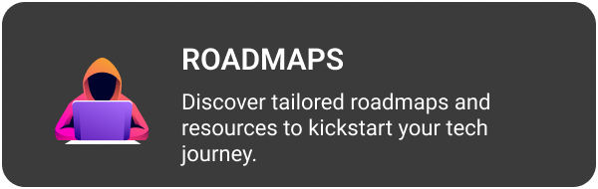
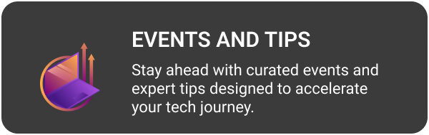
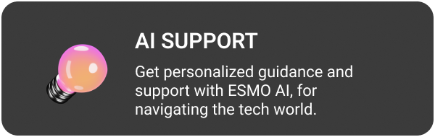

Features

Slide 6
Impact :
Educational Access: Makes coding accessible and reduces barriers for beginners.
Skill Development: Accelerates learning and builds a strong coding foundation.
Community Building: Fosters a supportive and collaborative learning community.
Career Opportunities: Enhances employability and bridges the tech industry skill gap

Slide 7
FEASIBILITY
Content and Quality depth
Feasible if tutorials are well-curated for beginners.
Requires regular updates and expert validation.
UX and Interface
Feasible with a clean, intuitive UI.
Challenges in balancing usability for varied skill levels.

Slide 8
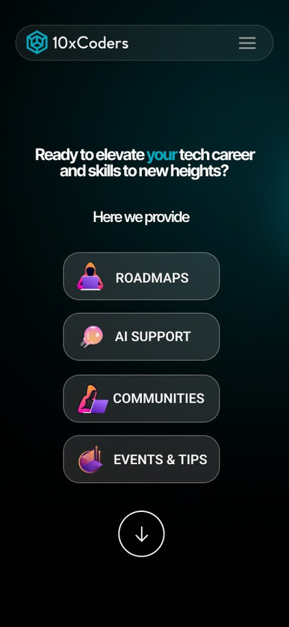
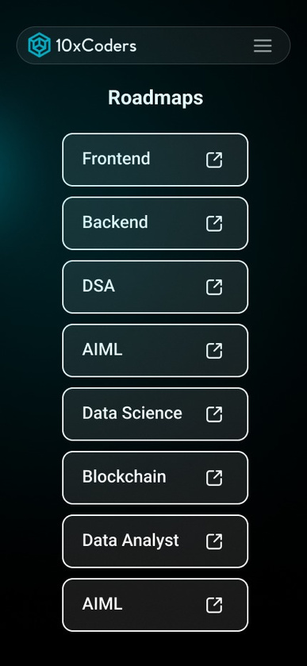
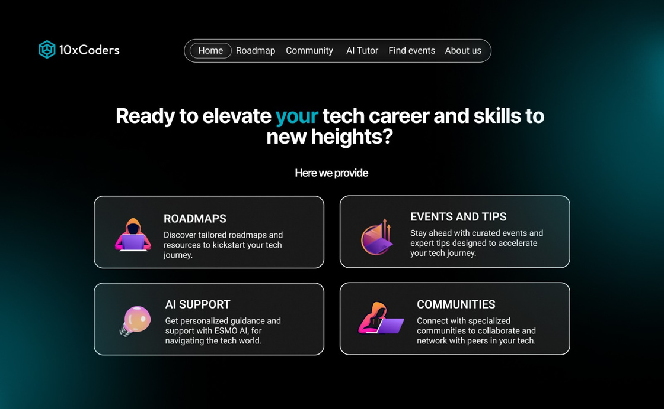
Product Mockup UI
Web App Mobile
Web Version PC

Slide 9
Content Expansion:
Scalable by adding more domains and tutorials.
Requires a robust CMS and clear structure.
User Base Growth:
Scalable with cloud services like AWS.
Needs advanced backend solutions for larger traffic.
Monetization:
Scalable with premium content and partnerships.
Balancing free and paid content can be challenging.

